Slide 1



Smart Care
A Database for Predictive System &Tailored Mental Health Management
Presented By:
Sruthi Puthiyandy(20307)
Supervised By:
Prof. Dr. Bhaskar, Vidhyacharan

Slide 2
Introduction
Problem and Solution
ER Diagram
Entities and Attributes
Table Of Content
Relationship
Tables
SQL Commands
Mathematical Notations
Conclusion
References

Slide 3

Purpose:
Predictive assessment system inspired from PHQ-9 and GAF .
Focus on providing personalized treatment plan and efficient provider allocation to patients.
Features:
Direct patient assessment linked to health record.
Automatic psychiatric score calculation to identify issues quickly.
Dynamic treatment plan generation using predefined triggers.
Seamless scheduling with most suitable provider available in the database based on specialization.
Tracking of Illness, Medication and Therapy
Introduction

Slide 4


What traditional psychiatric providers do?
Providers use pen and paper or non-integrated digital tools like PHQ-9/GAF scaling form to manually assess patients.
Assessments often relay on providers interpretation which leads variability in diagnosis.
Long wait time for initial assessment from a reputed clinic , low availability of specialists.
Many providers use paper based record systems so that its difficult to share records when patient consult to different specialized provider after reevaluation.
Patients often delay seeking care due to stigma or lack of awareness of available services.
Proposed System:
Ensuring centralized record-keeping and interoperability.
Automating assessments, psychiatric scoring, and treatment planning.
Assigning providers based on expertise rather than availability.
Facilitating patient engagement and follow-ups using predictive analytics.
Reducing costs through efficient processes and resource optimization.

Slide 5
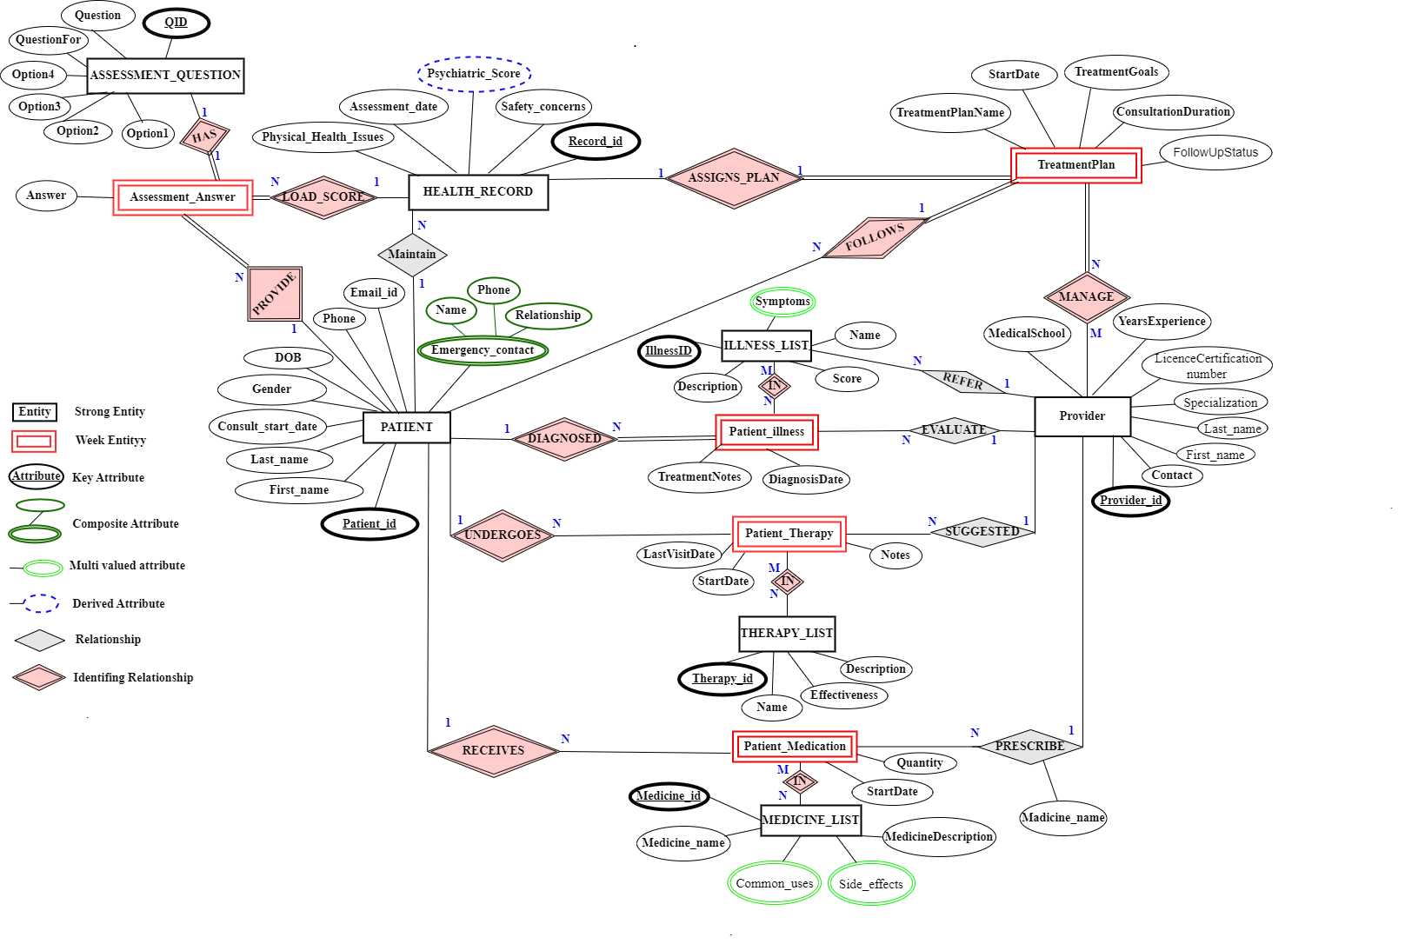
ER DIAGRAM

Slide 6
Strong Entities and Attributes
Entity Name | Attributes
PATIENT | PatientID, PatientFirstName, PatientLastName, PatientDOB, PatientGender, PatientEmail, PatientPhone, PatientConsultationStartDate, EmergencyContactName, EmergencyContactPhone, EmergencyContactRelationship
HEALTH_RECORD | RecordID, PatientID, PsychiatricScore, AssessmentDate, PhysicalHealthIssues, SafetyConcerns
ASSESSMENT_QUESTIONS | QuestionID, Question, Option1, Option2, Option3, Option4, QuestionFor
ILLNESS_LIST | IllnessID, IllnessName, IllnessDescription, IllnessSymptoms, PredefinedScore
MEDICINE_LIST | MedicineID, MedicineName, MedicineDescription, MedicineUses, MedicineSideEffects
THERAPY_LIST | TherapyID, TherapyName, TherapyDescription, TherapyEffectiveness
PROVIDER | ProviderID, FirstName, LastName, ContactInfo, Specialization, LicenceCertificationNumber, YearsExperience, MedicalSchool

Slide 7
Week Entities and Attributes
Entity | Attributes
Assessment_Answer | RecordID, QuestionID, PatientID, Answer
Patient_Illness | PatientID, IllnessID, ProviderId, DiagnosisDate, TreatmentNotes
Patient_Medication | PatientID, ProviderID, MedicineID, Quantity, StartDate
Patient_Therapy | TherapyID, PatientID, ProviderID, StartDate, LastVisitDate, Note
TreatmentPlan | PatientID, ProviderID, RecordID, TreatmentPlanName, StartDate, ConsultationDuration, TreatmentGoals, FollowUpStatus

Slide 8
Relationships
Relationship | From Entity | To Entity | Type | Cardinality
Patient Maintains Health Records | PATIENT | HEALTH_RECORD | Non-Identifying | 1-to-Many
Patient PROVIDES_ANSWER in ASSESSMENT_ANSWER | PATIENT | Assessment_answer | Identifying | 1-to-Many
Assessment Questions HAS Answer | ASSESSMENT_QUESTION | Assessment_Answer | Identifying | 1-to-1
Health Record LOAD_SCORE | HEALTH_RECORD | Assessment_answer | Identifying | 1-to-1
Health Record ASSIGN_PLAN in Treatment plan | HEALTH_RECORD | Treatment_Plan | Identifying | 1-to-1
Patient FOLLOWS Treatment Plan | PATIENT | Treatment_Plan | Identifying | 1-to-Many
Provider MANAGE Treatment plan | PROVIDER | Treatment_Plan | Identifying | 1-to-Many
Provider EVALUATE Patient Illness, Provider SUGGEST Patient_Therapy, Provider REFER illness_list, Provider PRESCRIBE medicine | PROVIDER | Patient_Illness Patient_Therapy ILLNESS_LIST Patient_Medicine | Non-Identifing | 1-to-Many
Patient Undergoes Patient_Therapy Patient DIAGNOSED Illness Patient RECEIVE Medicine | PATIENT | Patient_Therapy Patient_Illness Patient_Medication | Identifying | 1-to-Many

Slide 9
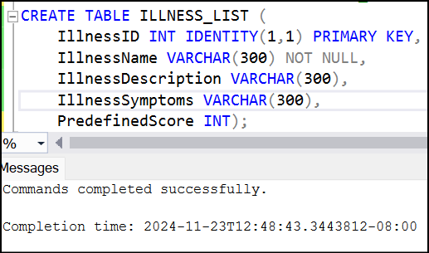
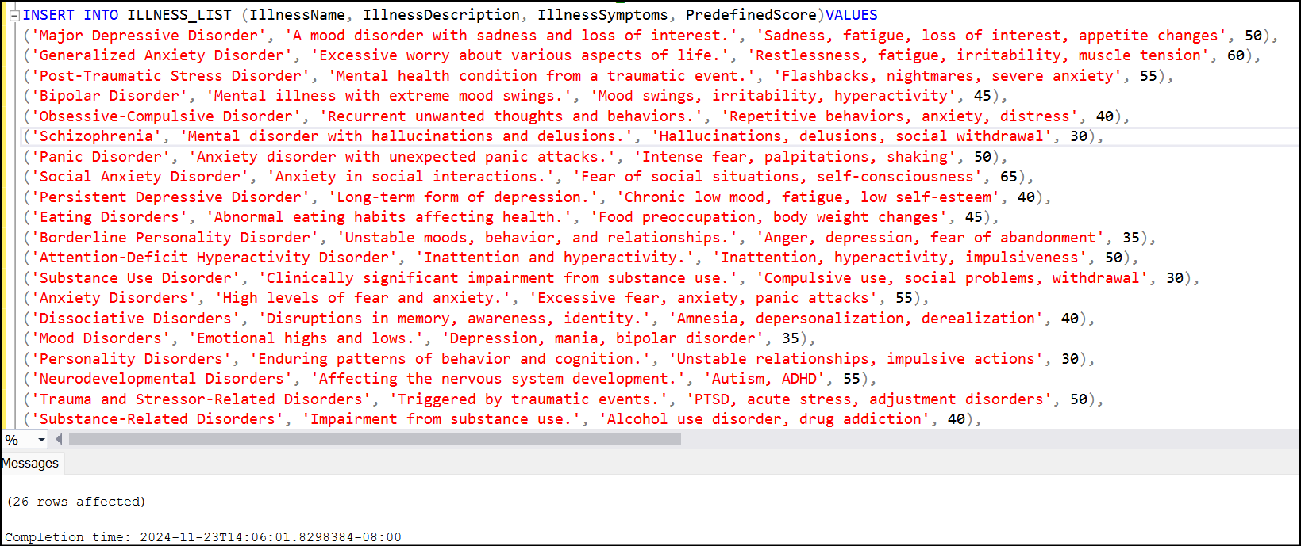
ILLNESS_LIST table
Create table
CREATE TABLE ILLNESS_LIST (
IllnessID INT IDENTITY(1,1) PRIMARY KEY,
IllnessName VARCHAR(300) NOT NULL,
IllnessDescription VARCHAR(300),
IllnessSymptoms VARCHAR(300),
PredefinedScore INT);
Insert Records

Slide 10
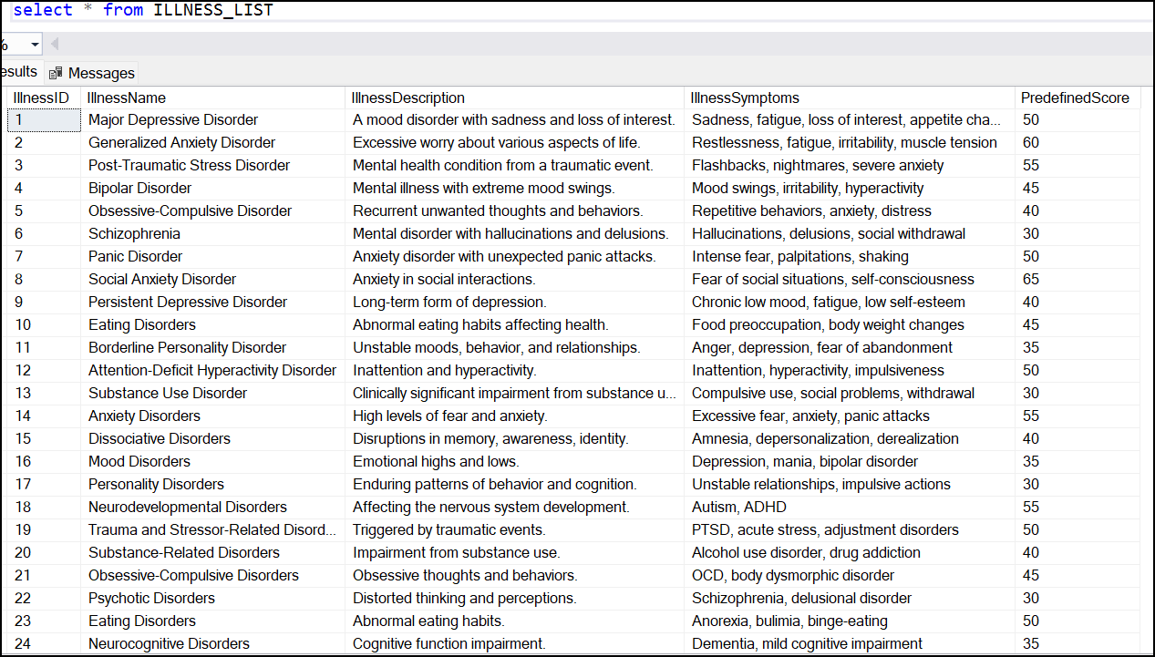
ILLNESS_LIST table
SELECT all data from table

Slide 11
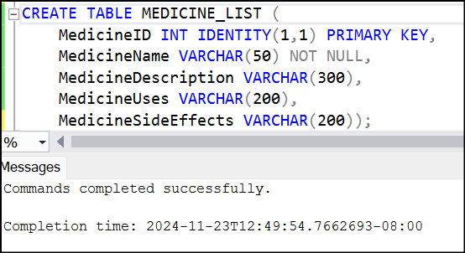
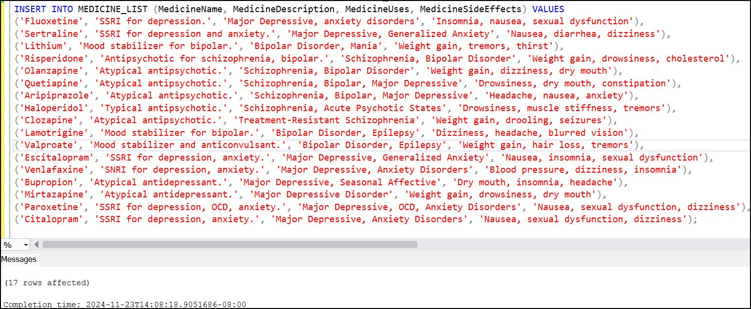
MEDICINE_LIST table
Create table
CREATE TABLE MEDICINE_LIST (
MedicineID INT IDENTITY(1,1) PRIMARY KEY,
MedicineName VARCHAR(50) NOT NULL,
MedicineDescription VARCHAR(300),
MedicineUses VARCHAR(200),
MedicineSideEffects VARCHAR(200));
Insert Records

Slide 12
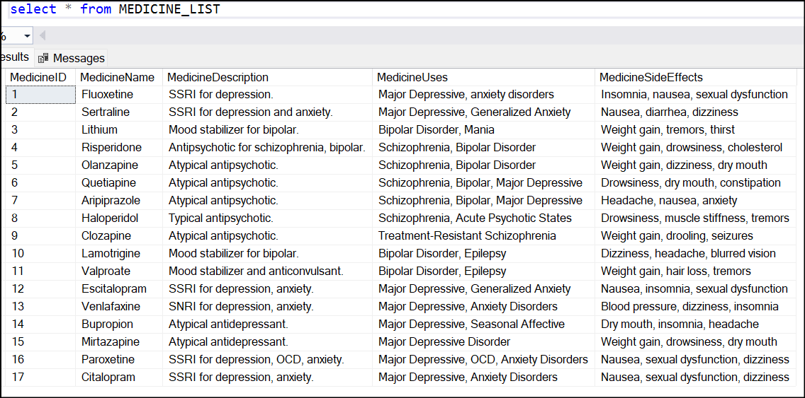
MEDICINE_LIST table
SELECT all data from table

Slide 13
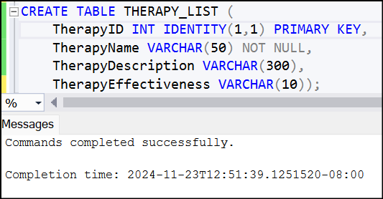
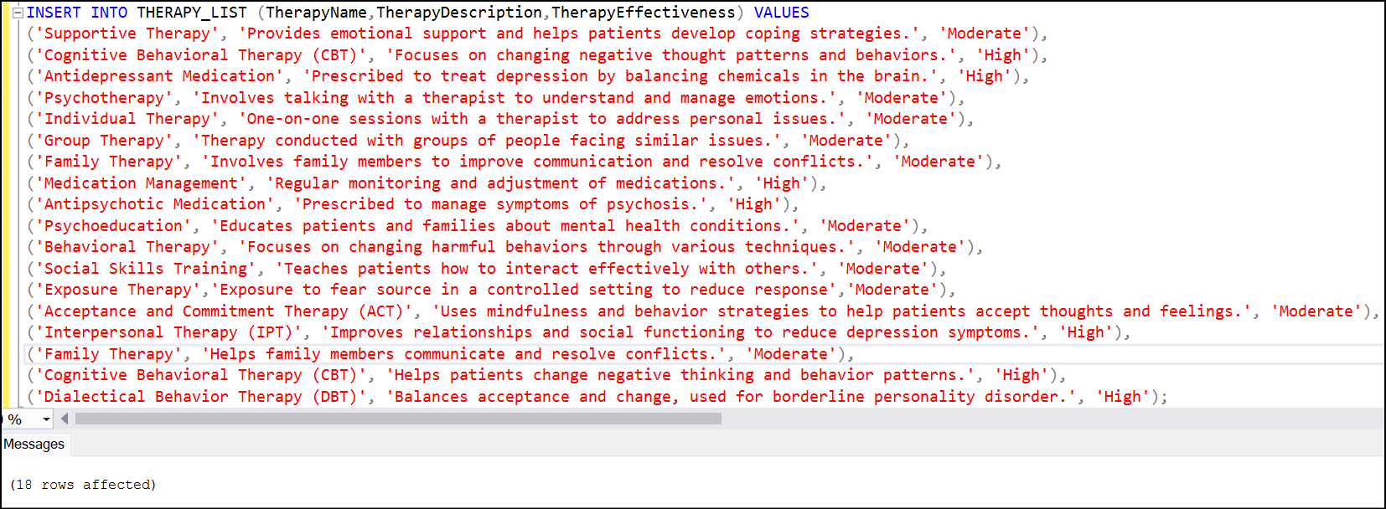
THERAPY_LIST table
Create table
CREATE TABLE THERAPY_LIST (
TherapyID INT IDENTITY(1,1) PRIMARY KEY,
TherapyName VARCHAR(50) NOT NULL,
TherapyDescription VARCHAR(300),
TherapyEffectiveness VARCHAR(10));
Insert Records

Slide 14
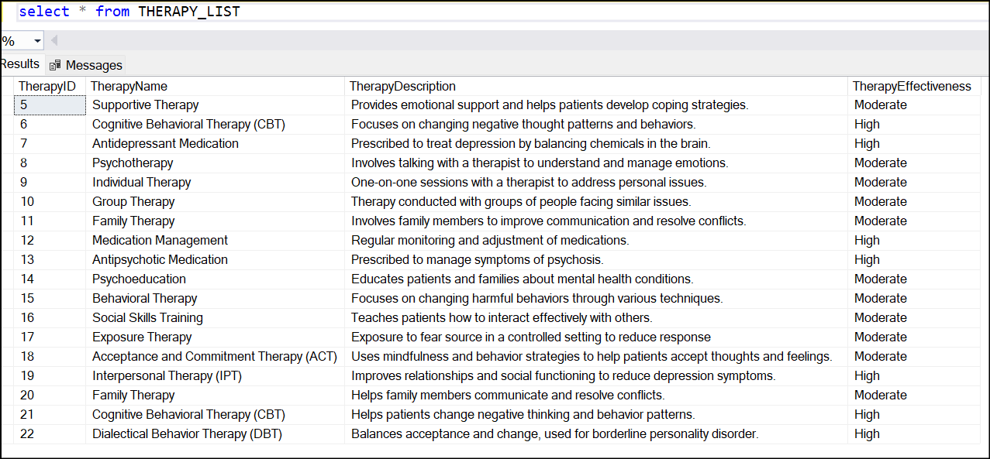
THERAPY_LIST table
SELECT all data from table

Slide 15
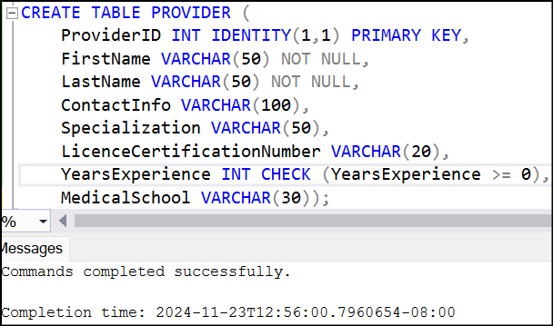
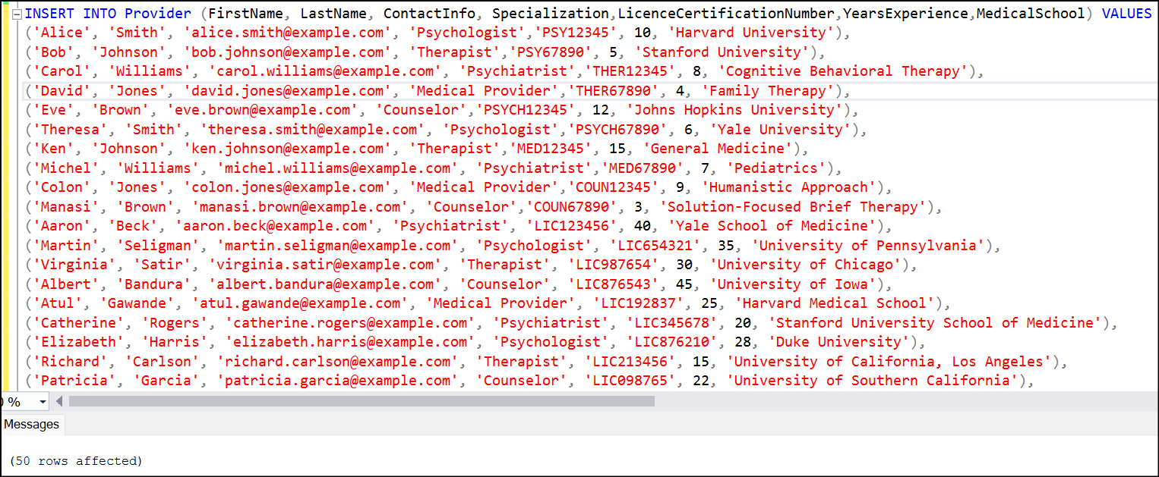
PROVIDER table
CREATE TABLE PROVIDER (
ProviderID INT IDENTITY(1,1) PRIMARY KEY,
FirstName VARCHAR(50) NOT NULL,
LastName VARCHAR(50) NOT NULL,
ContactInfo VARCHAR(100),
Specialization VARCHAR(50),
LicenceCertificationNumber VARCHAR(20),
YearsExperience INT CHECK (YearsExperience >= 0),
MedicalSchool VARCHAR(30));
Create table
Insert Records

Slide 16
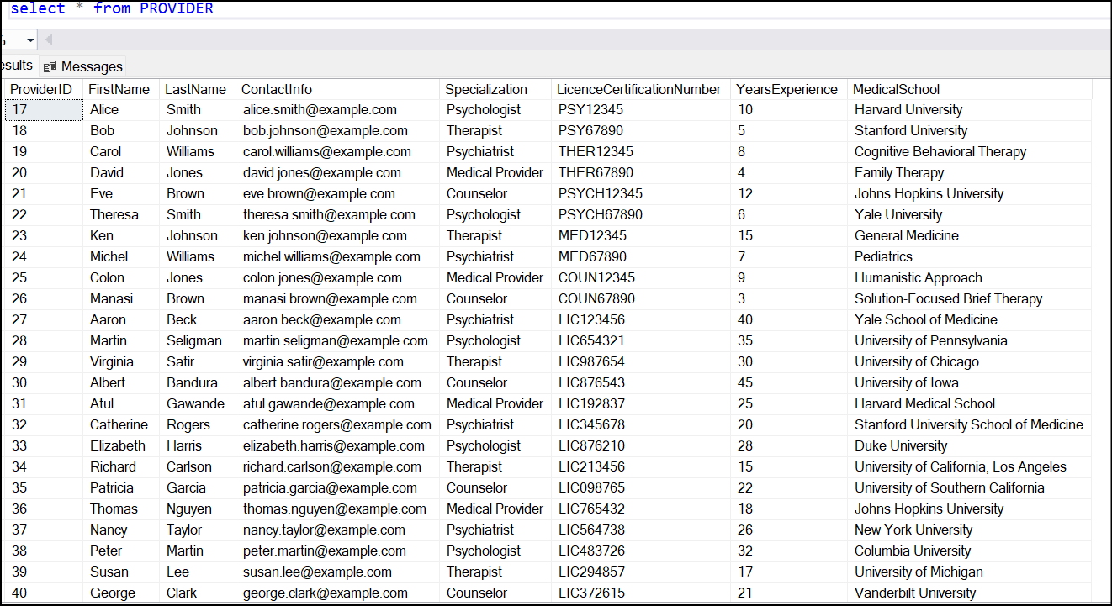
PROVIDER table
SELECT all data from table

Slide 17
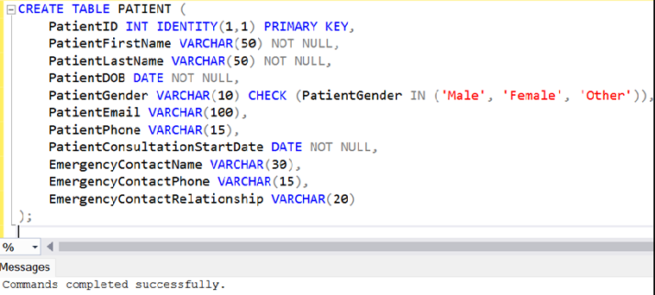
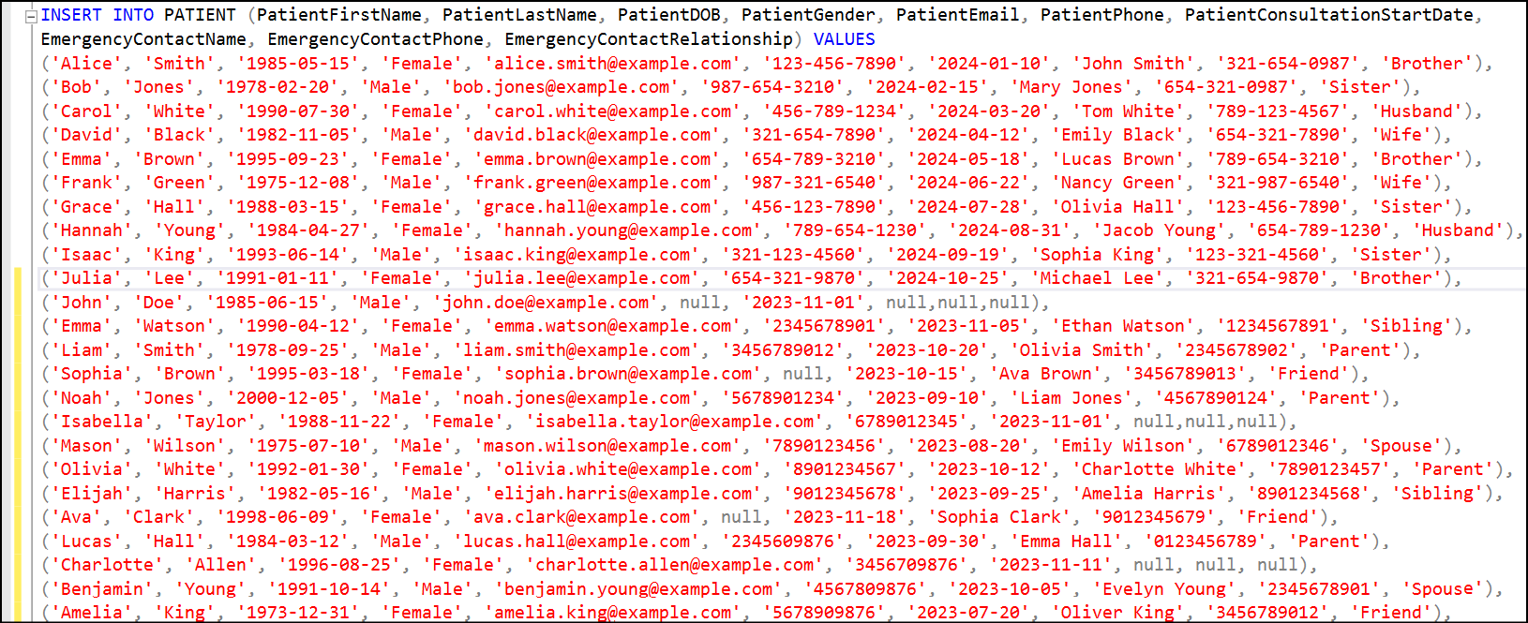
PATIENT table
CREATE TABLE PATIENT (
PatientID INT IDENTITY(1,1) PRIMARY KEY,
PatientFirstName VARCHAR(50) NOT NULL,
PatientLastName VARCHAR(50) NOT NULL,
PatientDOB DATE NOT NULL,
PatientGender VARCHAR(10),
CHECK (PatientGender IN('Male','Female‘,'Other')),
PatientEmail VARCHAR(100),
PatientPhone VARCHAR(15),
PatientConsultationStartDate DATE NOT NULL,
EmergencyContactName VARCHAR(30),
EmergencyContactPhone VARCHAR(15),
EmergencyContactRelationship VARCHAR(20));
Create table
Insert Records

Slide 18
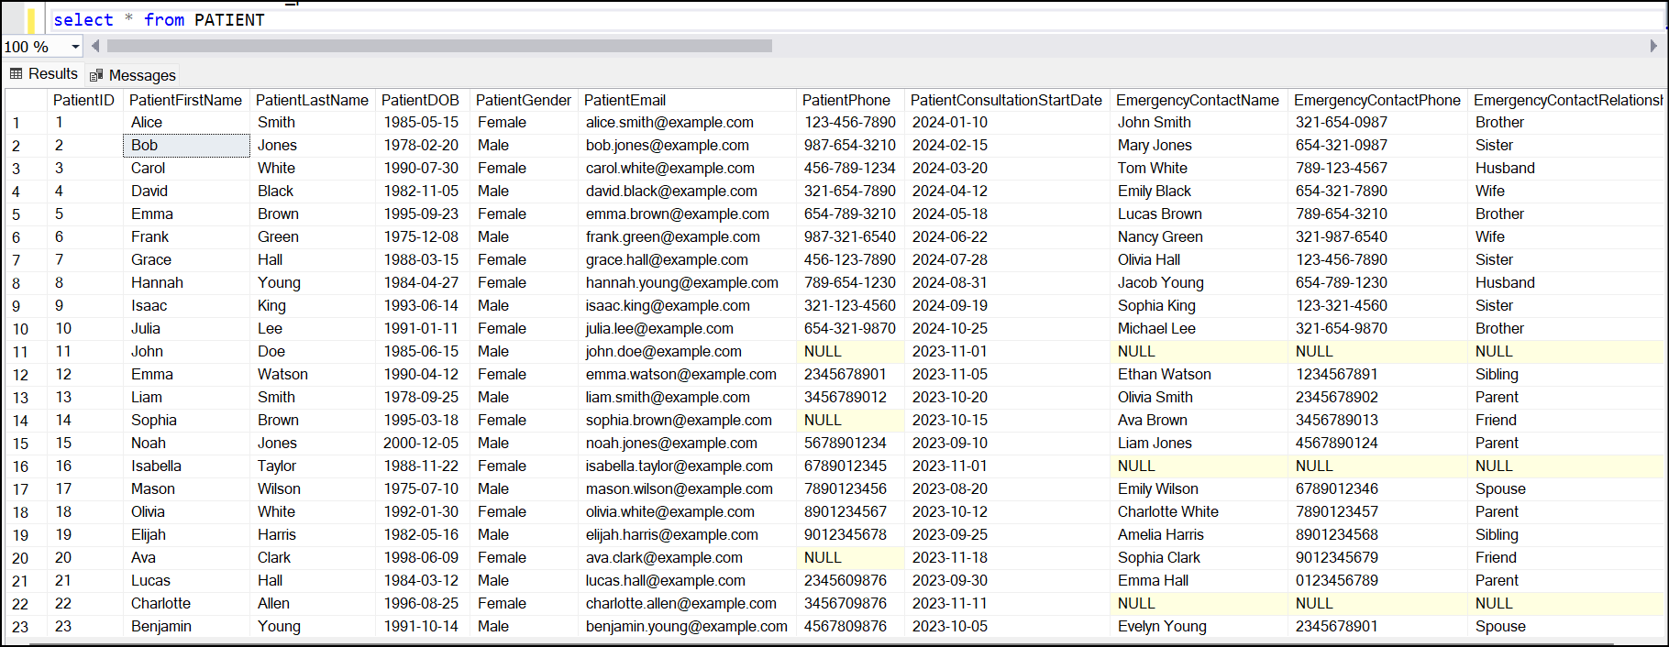
PATIENT table
SELECT all data from table

Slide 19
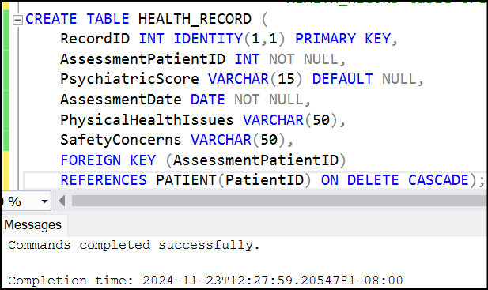
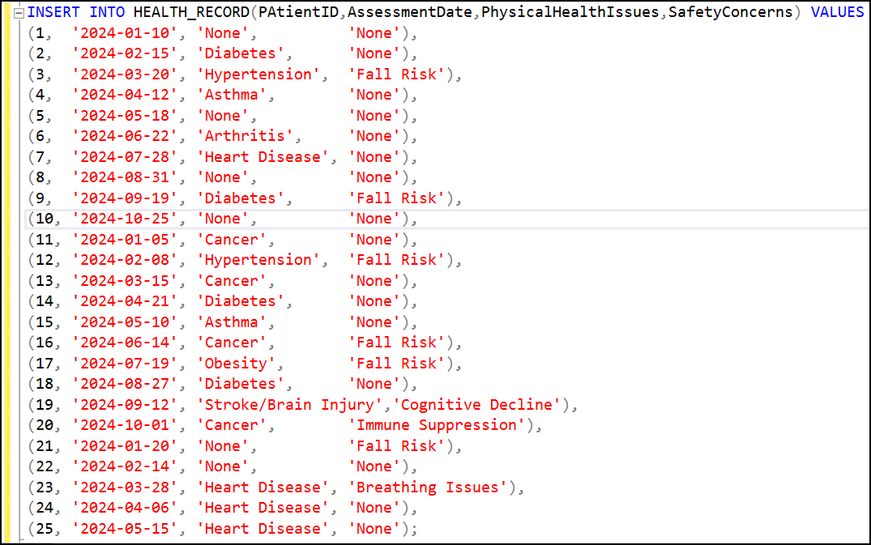
HEALTH_RECORD table
CREATE TABLE HEALTH_RECORD (
RecordID INT IDENTITY(1,1) PRIMARY KEY,
AssessmentPatientID INT NOT NULL,
PsychiatricScore VARCHAR(15) DEFAULT NULL,
AssessmentDate DATE NOT NULL,
PhysicalHealthIssues VARCHAR(50),
SafetyConcerns VARCHAR(50),
FOREIGN KEY (AssessmentPatientID) REFERENCES
PATIENT(PatientID) ON DELETE CASCADE);
Create table
Insert Records

Slide 20
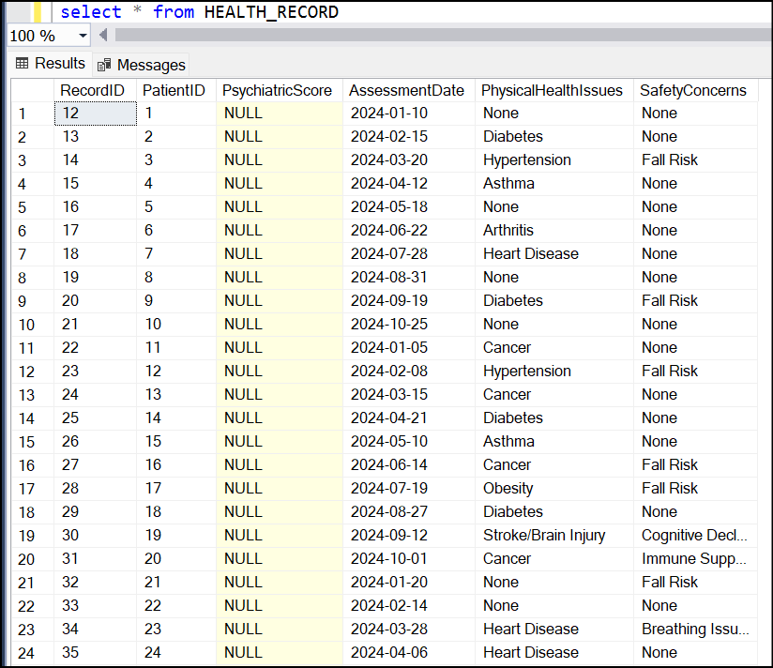
HEALTH_RECORD table
SELECT all data from table

Slide 21
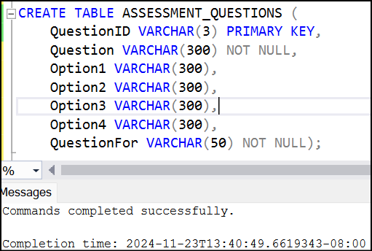
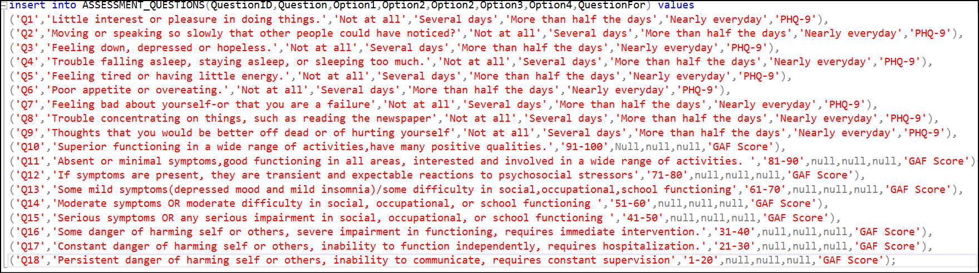
ASSESSMENT_QUESTIONS table
Create table
CREATE TABLE ASSESSMENT_QUESTIONS (
QuestionID VARCHAR(3) PRIMARY KEY,
Question VARCHAR(300) NOT NULL,
Option1 VARCHAR(300),
Option2 VARCHAR(300),
Option3 VARCHAR(300),
Option4 VARCHAR(300),
QuestionFor VARCHAR(50) NOT NULL);
Insert Records

Slide 22
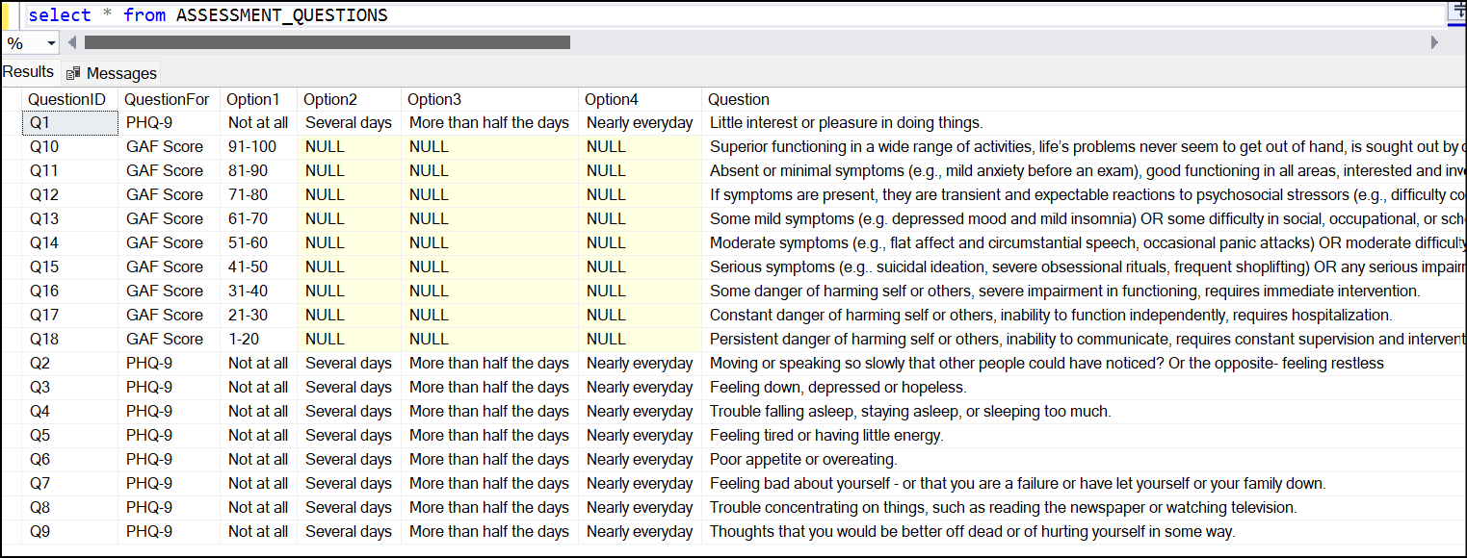
ASSESSMENT_QUESTIONS table
SELECT all data from table

Slide 23
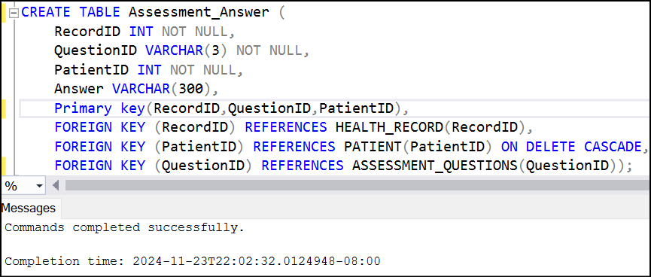
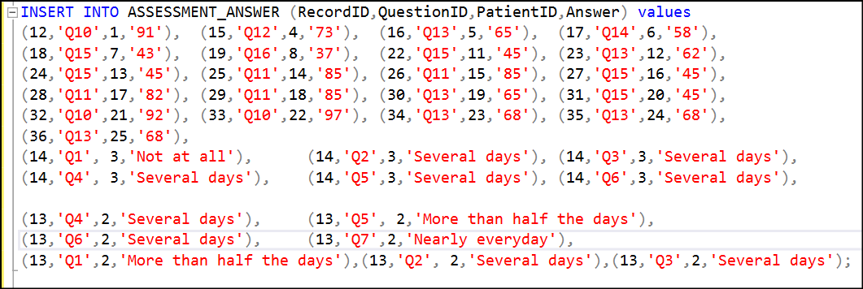
ASSESSMENT_ANSWER table
Create table
CREATE TABLE Assessment_Answer (
RecordID INT NOT NULL,
QuestionID VARCHAR(3) NOT NULL,
PatientID INT NOT NULL,
Answer VARCHAR(300),
Primary key(RecordID,QuestionID,PatientID),
FOREIGN KEY (RecordID) REFERENCE
HEALTH_RECORD(RecordID),
FOREIGN KEY (PatientID) REFERENCES
PATIENT(PatientID) ON DELETE CASCADE,
FOREIGN KEY (QuestionID) REFERENCES
ASSESSMENT_QUESTIONS(QuestionID));
Insert Records

Slide 24
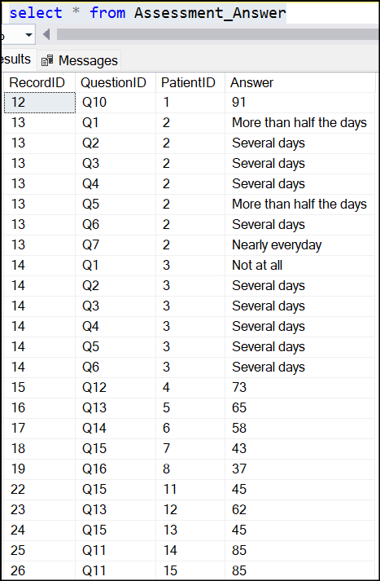
ASSESSMENT_ANSWER table
SELECT all data from table

Slide 25
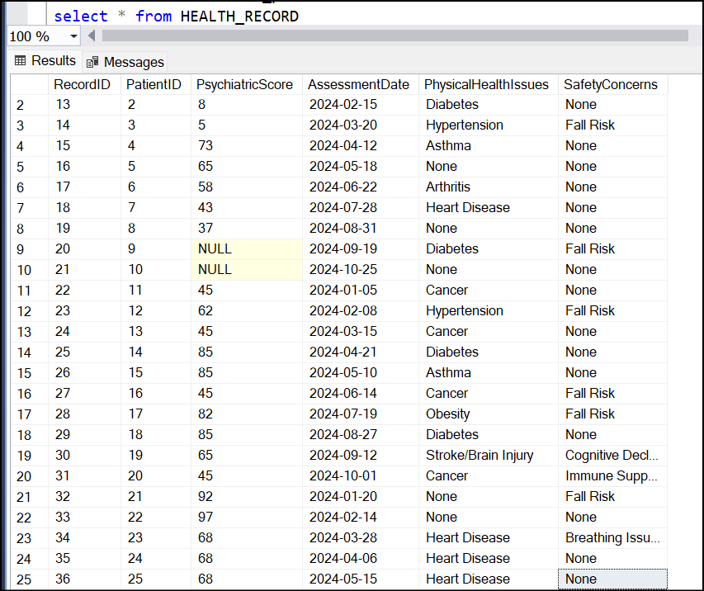
HEALTH_RECORD table
Updated with psychiatric score

Slide 26
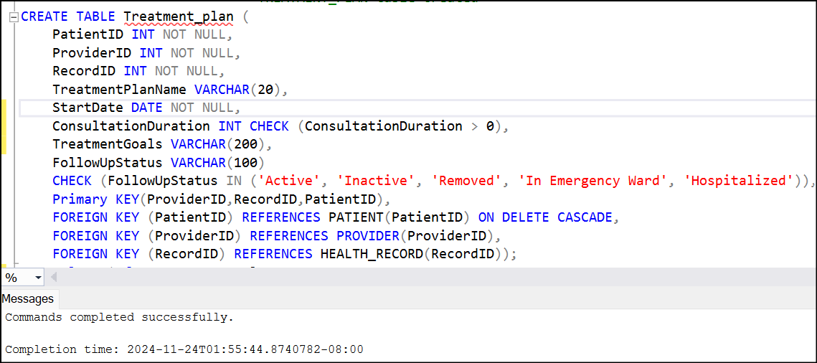
TREATMENT_PLAN table
Create table
CREATE TABLE Treatment_plan (
PatientID INT NOT NULL,
ProviderID INT NOT NULL,
RecordID INT NOT NULL,
TreatmentPlanName VARCHAR(20),
StartDate DATE NOT NULL,
ConsultationDuration INT CHECK
(ConsultationDuration > 0),
TreatmentGoals VARCHAR(200),
FollowUpStatus VARCHAR(100)
CHECK (FollowUpStatus IN
('Active', 'Inactive', 'Removed', 'In Emergency Ward', 'Hospitalized')),
Primary KEY(ProviderID,RecordID,PatientID),
FOREIGN KEY (PatientID) REFERENCES PATIENT(PatientID) ON DELETE CASCADE,
FOREIGN KEY (ProviderID) REFERENCES PROVIDER(ProviderID),
FOREIGN KEY (RecordID) REFERENCES HEALTH_RECORD(RecordID));
Insert Records
Treatment_plan table automatically gets updated with the plan defined by the system using trigger referring psychiatric score calculated and loaded in HEALTH_RECORD table.

Slide 27
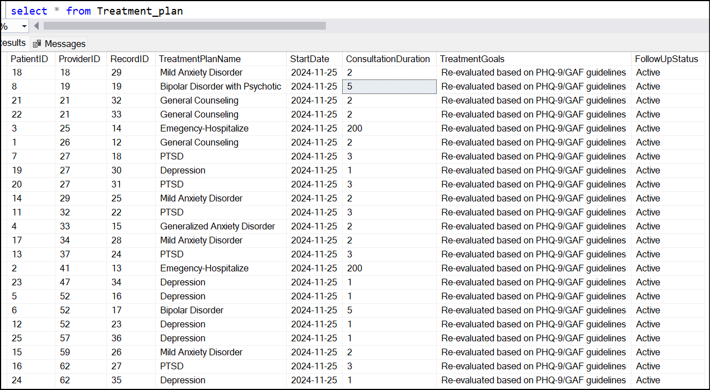
Treatment_plan table
SELECT all data from table

Slide 28
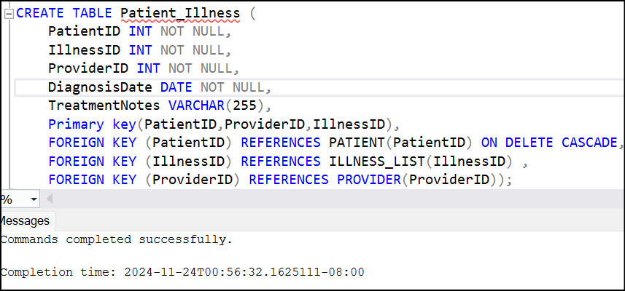
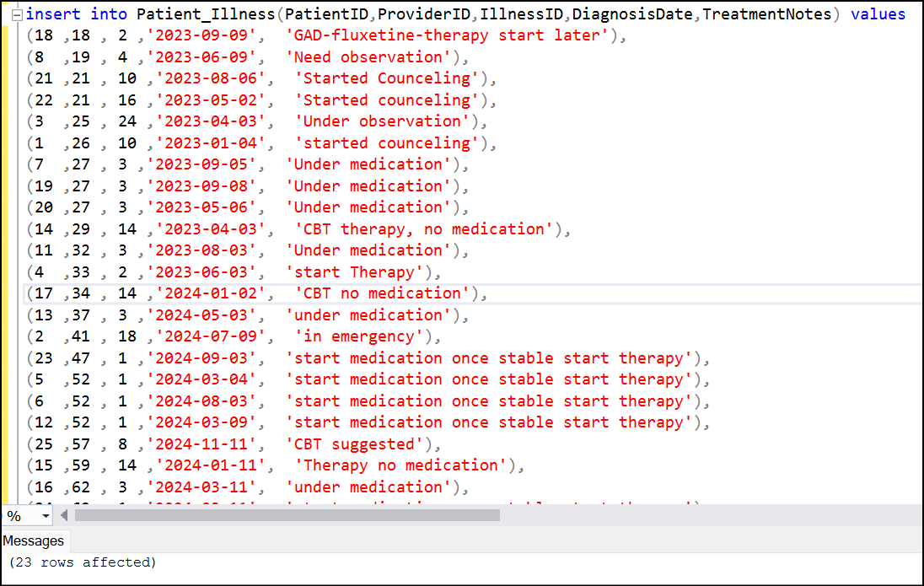
Patient_Illness table
CREATE TABLE Patient_Illness (
PatientID INT NOT NULL,
IllnessID INT NOT NULL,
ProviderID INT NOT NULL,
DiagnosisDate DATE NOT NULL,
TreatmentNotes VARCHAR(255),
Primary key(PatientID,ProviderID,IllnessID),
FOREIGN KEY (PatientID) REFERENCES PATIENT(PatientID) ON DELETE CASCADE,
FOREIGN KEY (IllnessID) REFERENCES ILLNESS_LIST(IllnessID),
FOREIGN KEY (ProviderID) REFERENCE PROVIDER(ProviderID));
Create Table
Insert Records

Slide 29
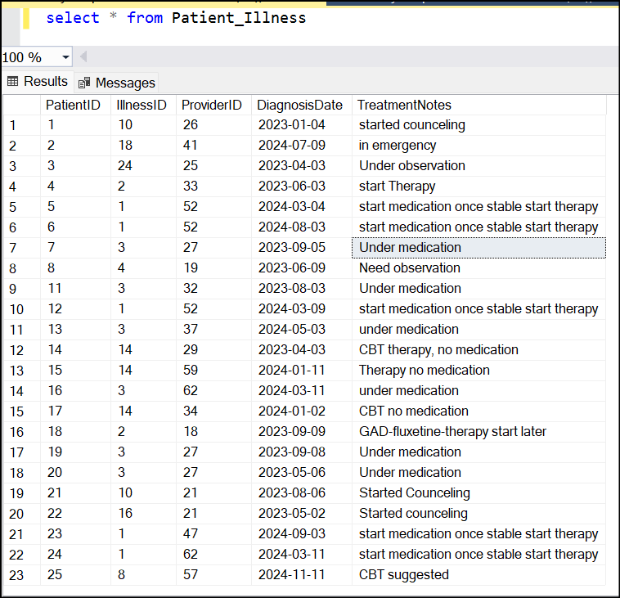
Patient_Illness table
SELECT all data from table

Slide 30
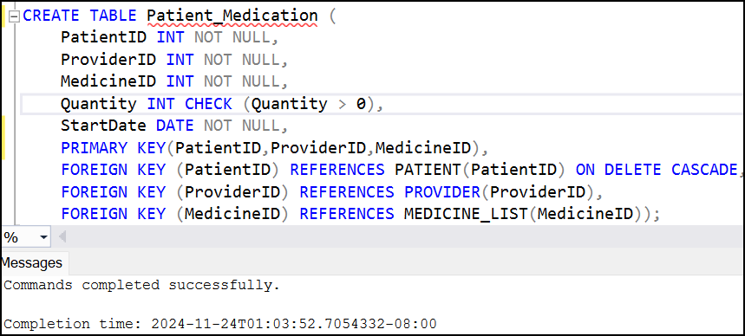
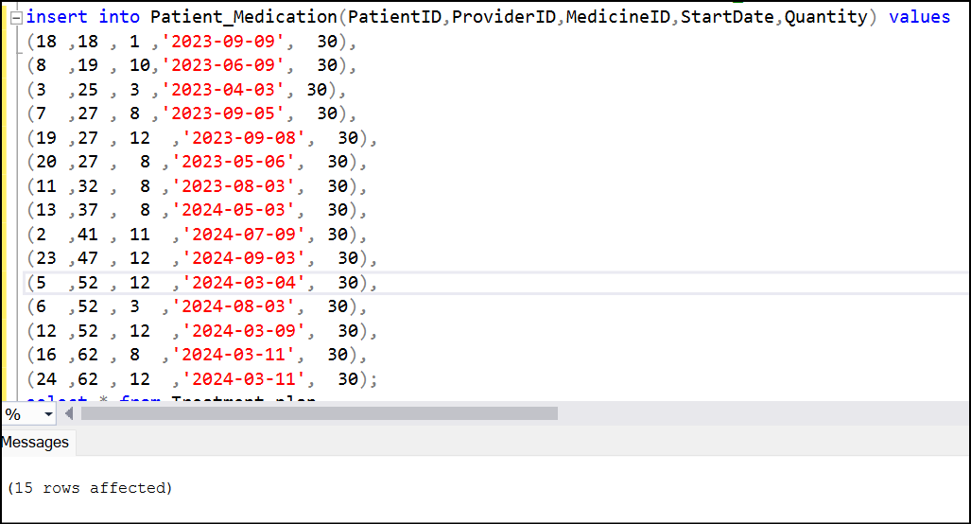
Patient_Medication table
Create table
CREATE TABLE Patient_Medication (
PatientID INT NOT NULL,
ProviderID INT NOT NULL,
MedicineID INT NOT NULL,
Quantity INT CHECK (Quantity > 0),
StartDate DATE NOT NULL,
PRIMARY KEY(PatientID,ProviderID,MedicineID),
FOREIGN KEY (PatientID) REFERENCES PATIENT(PatientID) ON DELETE CASCADE,
FOREIGN KEY (ProviderID) REFERENCES PROVIDER(ProviderID),
FOREIGN KEY (MedicineID) REFERENCES MEDICINE_LIST(MedicineID));
Insert Records

Slide 31
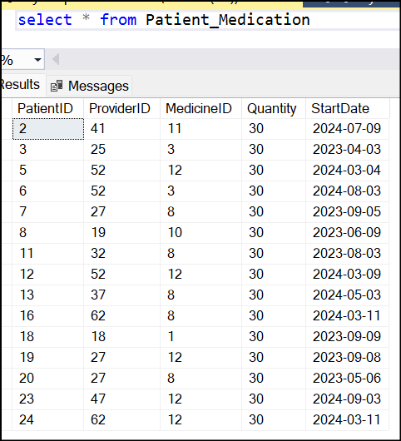
Patient_Medication table
SELECT all data from table

Slide 32
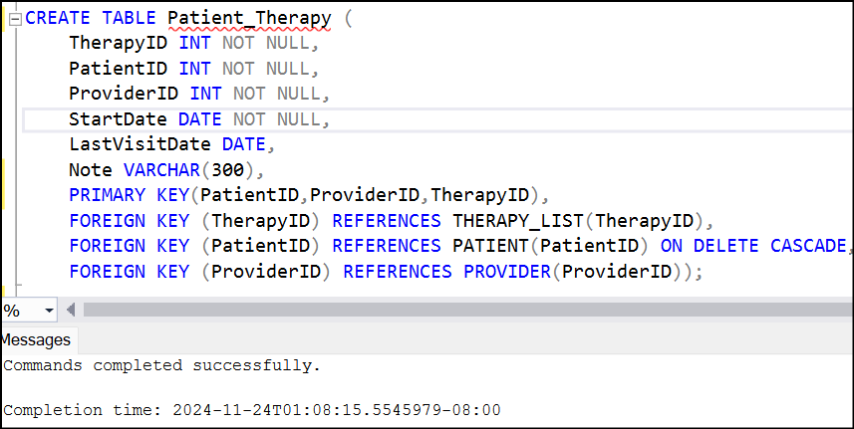
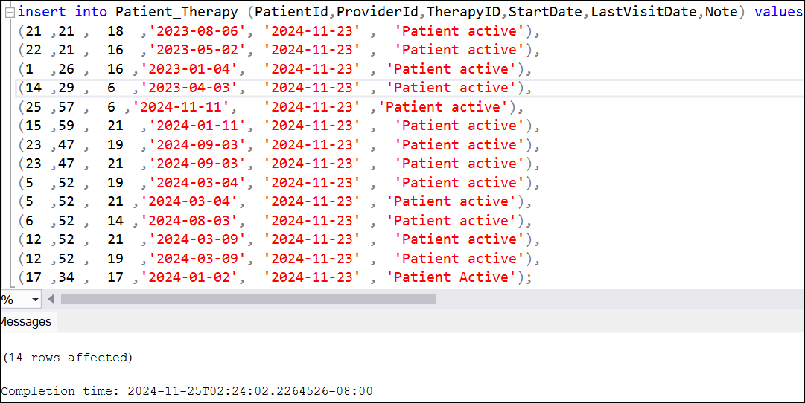
Patient_Therapy table
CREATE TABLE Patient_Therapy (
TherapyID INT NOT NULL,
PatientID INT NOT NULL,
ProviderID INT NOT NULL,
StartDate DATE NOT NULL,
LastVisitDate DATE,
Note VARCHAR(300),
PRIMARY KEY(PatientID,ProviderID,TherapyID),
FOREIGN KEY (TherapyID) REFERENCES THERAPY_LIST(TherapyID),
FOREIGN KEY (PatientID) REFERENCES PATIENT(PatientID) ON DELETE CASCADE,
FOREIGN KEY (ProviderID) REFERENCES PROVIDER(ProviderID));
Create table
Insert Records

Slide 33
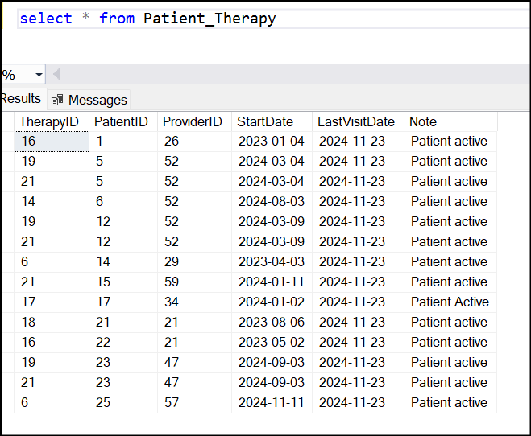
Patient_Therapy table
SELECT all data from table

Slide 34
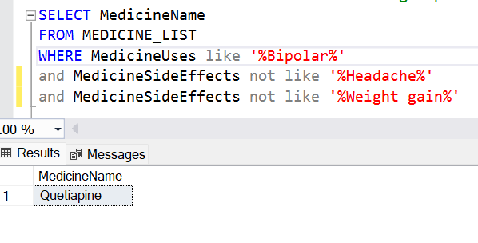
BASIC SQL QUERIES
Fetch the names of medicines used for treating bipolar disorder and do not have the side effects of headache and weight gain.
SELECT MedicineName
FROM MEDICINE_LIST
WHERE MedicineUses like '%Bipolar%'
and MedicineSideEffects not like '%Headache%'
and MedicineSideEffects not like '%Weight gain%’;

Slide 35
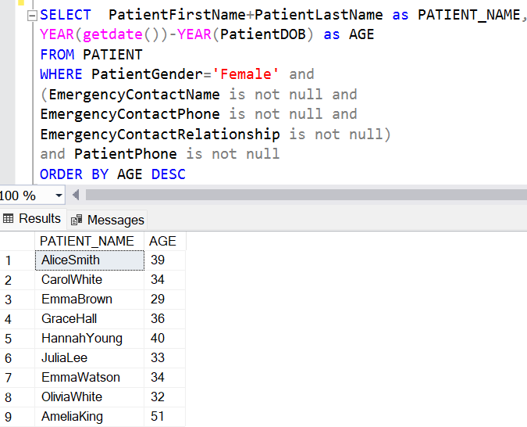
BASIC SQL QUERIES
Retrieve names of female patients, calculate age from date of birth; if they have emergency details and personal contact details in PATIENT table.
SELECT PatientFirstName+PatientLastName as PATIENT_NAME,
YEAR(getdate())-YEAR(PatientDOB) as AGE
FROM PATIENT
WHERE PatientGender='Female' and
(EmergencyContactName is not null and
EmergencyContactPhone is not null and
EmergencyContactRelationship is not null)
and PatientPhone is not null
ORDER BY AGE DESC

Slide 36
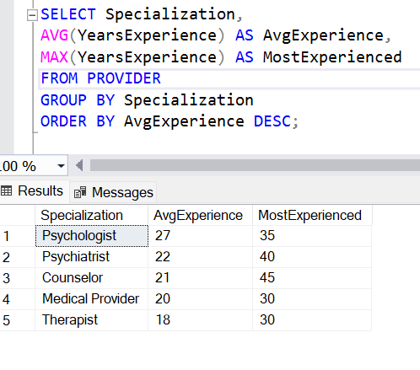
BASIC SQL QUERIES
Fetch the average and maximum experience in each specialization of providers and display average experience in descending order
SELECT Specialization,
AVG(YearsExperience) AS AvgExperience,
MAX(YearsExperience) AS MostExperienced
FROM PROVIDER
GROUP BY Specialization
ORDER BY AvgExperience DESC;

Slide 37
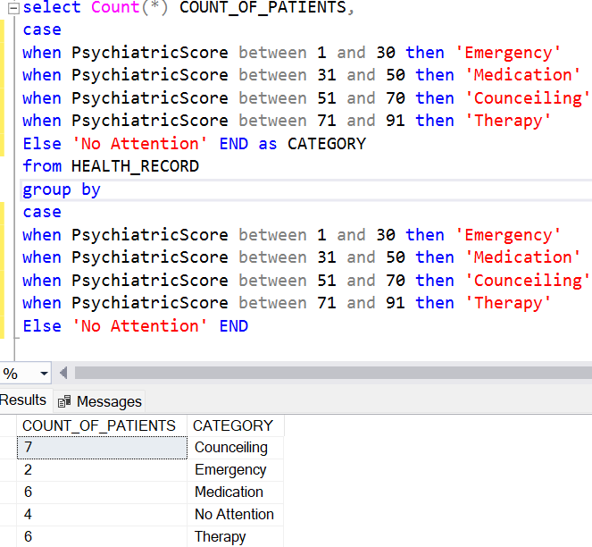
BASIC SQL QUERIES
Count the number of patients in different categories based on their psychiatric scores, specifically between 1-30 for 'Emergency Patients', 31-50 for 'Medication Category', 51-70 for 'Counseling Category', and 71-91 for 'Therapy'
select Count(*) COUNT_OF_PATIENTS,
case
when PsychiatricScore between 1 and 30 then 'Emergency'
when PsychiatricScore between 31 and 50 then 'Medication'
when PsychiatricScore between 51 and 70 then 'Counceiling'
when PsychiatricScore between 71 and 91 then 'Therapy'
Else 'No Attention' END as CATEGORY
from HEALTH_RECORD
group by
case
when PsychiatricScore between 1 and 30 then 'Emergency'
when PsychiatricScore between 31 and 50 then 'Medication'
when PsychiatricScore between 51 and 70 then 'Counceiling'
when PsychiatricScore between 71 and 91 then 'Therapy'
Else 'No Attention' END

Slide 38
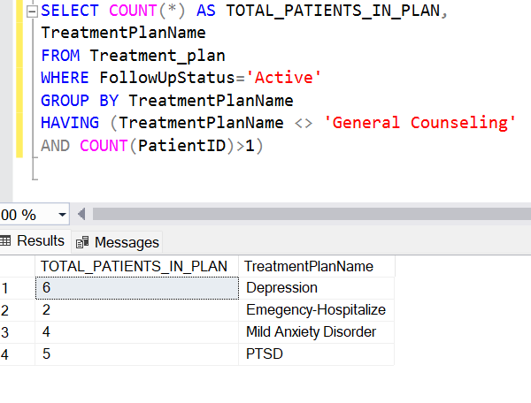
BASIC SQL QUERIES
Get count of active patients in each treatment plan exclude ‘General Counseling’ and count of patients should be greater then 1.
SELECT COUNT(*) AS TOTAL_PATIENTS_IN_PLAN,
TreatmentPlanName
FROM Treatment_plan
WHERE FollowUpStatus='Active'
GROUP BY TreatmentPlanName
HAVING (TreatmentPlanName <> 'General Counseling'
AND COUNT(PatientID)>1)

Slide 39
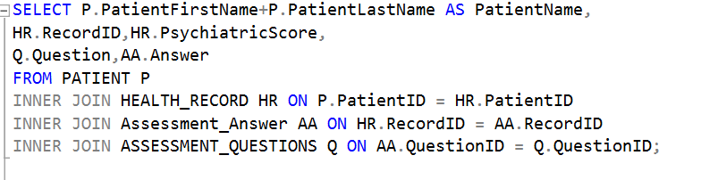
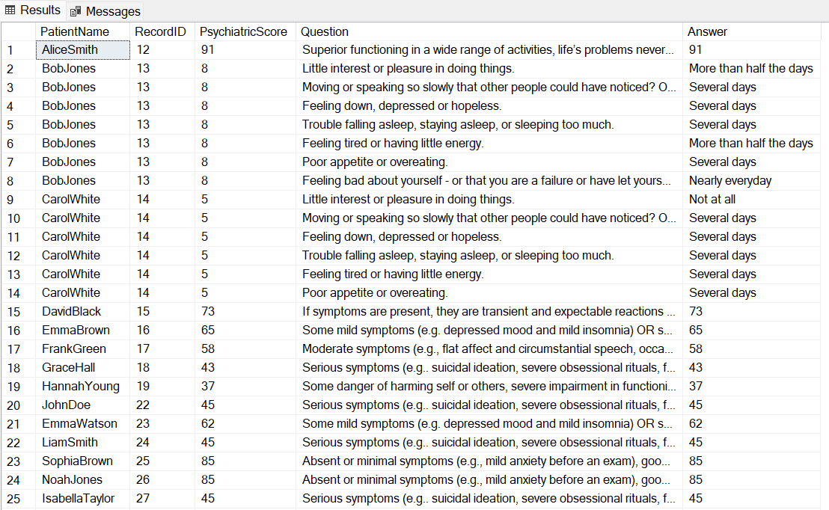
INTERMEDIATE SQL QUERIES
Retrieve each patients assessment record with question and answers.
SELECT P.PatientFirstName+P.PatientLastName
AS PatientName,
HR.RecordID,HR.PsychiatricScore,
Q.Question,AA.Answer
FROM PATIENT P
INNER JOIN HEALTH_RECORD HR
ON P.PatientID = HR.PatientID
INNER JOIN Assessment_Answer AA
ON HR.RecordID = AA.RecordID
INNER JOIN ASSESSMENT_QUESTIONS Q
ON AA.QuestionID = Q.QuestionID;

Slide 40
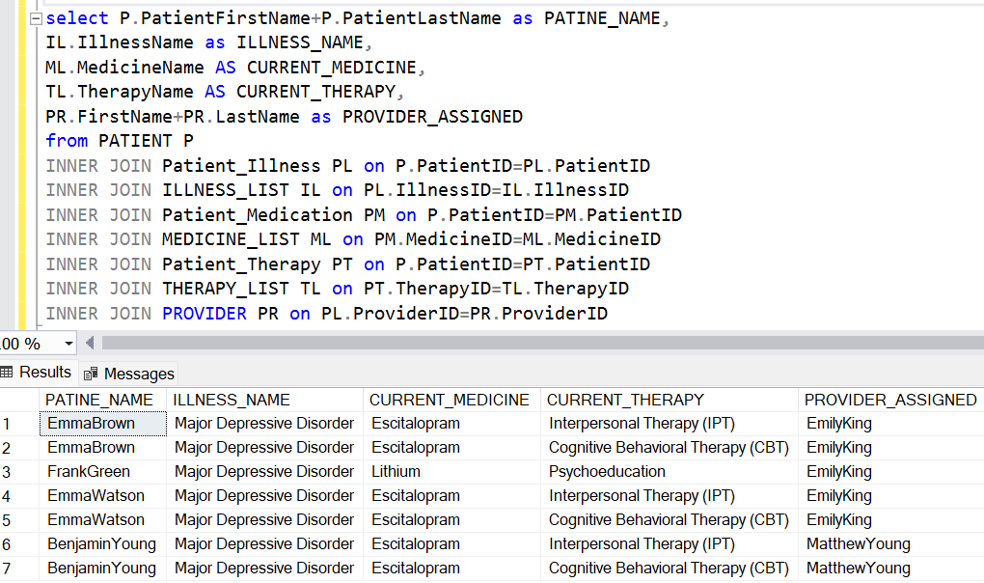
INTERMEDIATE SQL QUERIES
List patient assigned with providers and has medication and therapy assigned.
select P.PatientFirstName+P.PatientLastName as PATINE_NAME,
IL.IllnessName as ILLNESS_NAME,
ML.MedicineName AS CURRENT_MEDICINE,
TL.TherapyName AS CURRENT_THERAPY,
PR.FirstName+PR.LastName as PROVIDER_ASSIGNED
from PATIENT P
INNER JOIN Patient_Illness PL on P.PatientID=PL.PatientID
INNER JOIN ILLNESS_LIST IL on PL.IllnessID=IL.IllnessID
INNER JOIN Patient_Medication PM on P.PatientID=PM.PatientID
INNER JOIN MEDICINE_LIST ML on PM.MedicineID=ML.MedicineID
INNER JOIN Patient_Therapy PT on P.PatientID=PT.PatientID
INNER JOIN THERAPY_LIST TL on PT.TherapyID=TL.TherapyID
INNER JOIN PROVIDER PR on PL.ProviderID=PR.ProviderID

Slide 41
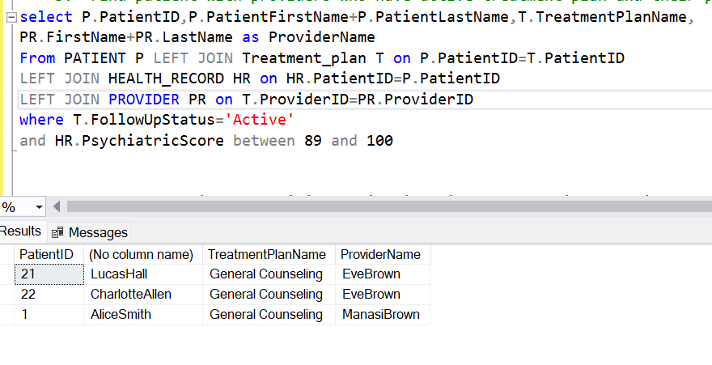
INTERMEDIATE SQL QUERIES
Patient with providers who have active treatment plan and their psychiatric score greater from 89 to 100.
select P.PatientID,P.PatientFirstName+P.PatientLastName,
T.TreatmentPlanName,
PR.FirstName+PR.LastName as ProviderName
From PATIENT P LEFT JOIN Treatment_plan T on P.PatientID=T.PatientID
LEFT JOIN HEALTH_RECORD HR on HR.PatientID=P.PatientID
LEFT JOIN PROVIDER PR on T.ProviderID=PR.ProviderID
where T.FollowUpStatus='Active'
and HR.PsychiatricScore between 89 and 100

Slide 42
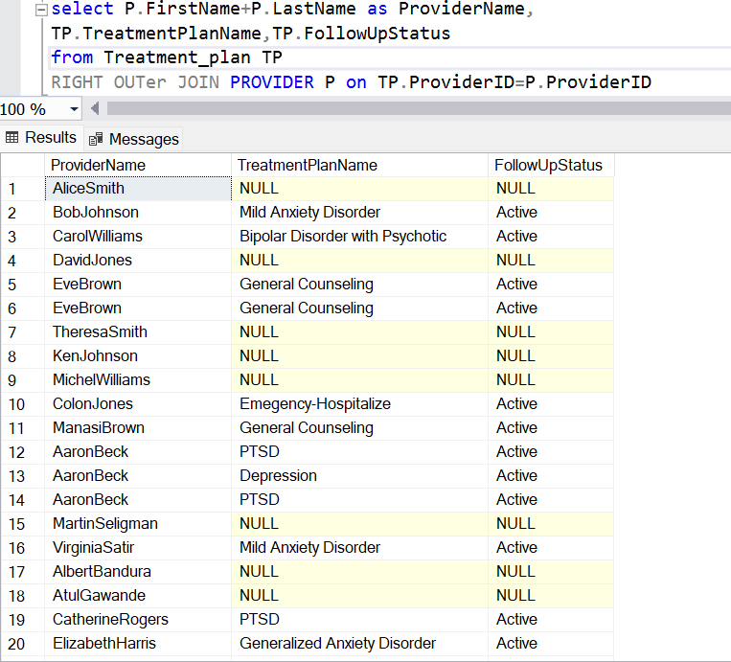
INTERMEDIATE SQL QUERIES
Get Provider information like name and specialization who have assigned with/without a treatment plan, and scheduled treatment plan for each provider and their follow up status
select P.FirstName+P.LastName
as ProviderName,
TP.TreatmentPlanName,
TP.FollowUpStatus
from Treatment_plan TP
RIGHT OUTER JOIN PROVIDER P on TP.ProviderID=P.ProviderID

Slide 43
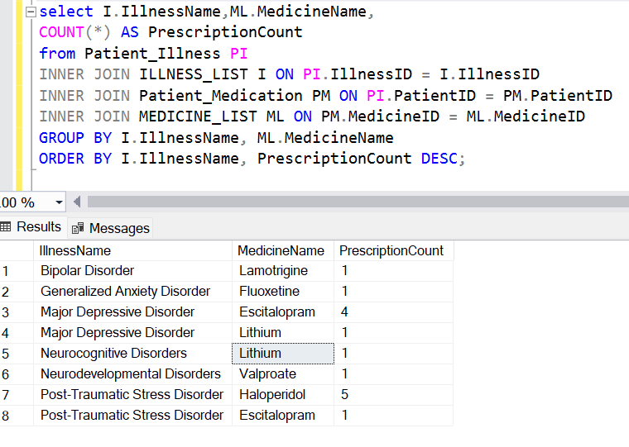
INTERMEDIATE SQL QUERIES
Find the most commonly prescribed medicines for each illness, including the number of times prescribed.
select I.IllnessName,ML.MedicineName,
COUNT(*) AS PrescriptionCount
from Patient_Illness PI
INNER JOIN ILLNESS_LIST I
ON PI.IllnessID = I.IllnessID
INNER JOIN Patient_Medication PM
ON PI.PatientID = PM.PatientID
INNER JOIN MEDICINE_LIST ML
ON PM.MedicineID = ML.MedicineID
GROUP BY I.IllnessName, ML.MedicineName
ORDER BY I.IllnessName, PrescriptionCount DESC;

Slide 44
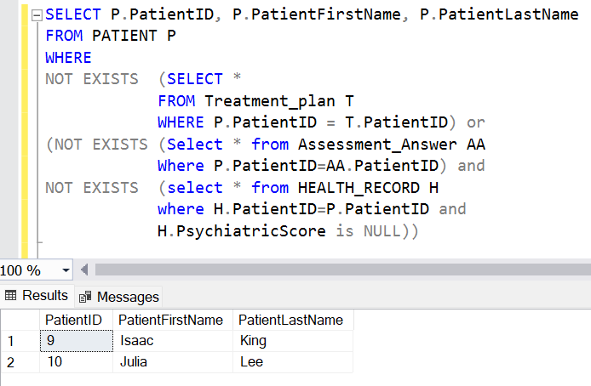
ADVANCED SQL QUERIES
List the patients who do not have a assigned treatment plan/provider in treatment table.
SELECT P.PatientID, P.PatientFirstName, P.PatientLastName
FROM PATIENT P
WHERE NOT EXISTS
(SELECT *
FROM Treatment_plan T
WHERE P.PatientID = T.PatientID) or
(NOT EXISTS
(Select * from Assessment_Answer AA
Where P.PatientID=AA.PatientID) and
NOT EXISTS
(select * from HEALTH_RECORD H
where H.PatientID=P.PatientID and
H.PsychiatricScore is NULL))

Slide 45
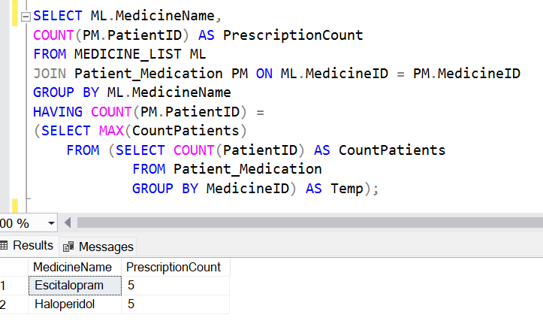
ADVANCED SQL QUERIES
Retrieve the most prescribed medication which have maximum number of patients as customers to keep in refill the stock in pharmacy.
SELECT ML.MedicineName,
COUNT(PM.PatientID) AS PrescriptionCount
FROM MEDICINE_LIST ML
JOIN Patient_Medication PM ON ML.MedicineID = PM.MedicineID
GROUP BY ML.MedicineName
HAVING COUNT(PM.PatientID) =
(SELECT MAX(CountPatients)
FROM (SELECT COUNT(PatientID) AS CountPatients
FROM Patient_Medication
GROUP BY MedicineID) AS Temp);

Slide 46

ADVANCED SQL QUERIES
Analyze the effective ness of therapy which has highest number of patients marked with active, improved follow up status.
SELECT TherapyName,
COUNT(*) AS TotalPatients
FROM Therapy_List
WHERE TherapyID IN (
SELECT TherapyID
FROM Patient_Therapy
WHERE PatientID IN (
SELECT PatientID
FROM Treatment_plan
WHERE FollowUpStatus IN ('Active', 'Improved')
)
)
GROUP BY TherapyName
ORDER BY TotalPatients DESC;

Slide 47

ADVANCED SQL QUERIES
Select the patients and treatment plan who are under medication without therapy.
SELECT P.PatientID,
P.PatientFirstName,T.TreatmentPlanName
FROM Patient P
Inner join Treatment_plan T
on P.PatientID=T.PatientID
WHERE P.PatientID IN (
SELECT PatientID
FROM Patient_Medication
WHERE PatientID NOT IN (
SELECT PatientID
FROM Patient_Therapy));

Slide 48

ADVANCED SQL QUERIES
Calculate by evaluating different patients in the system. How the psychiatric score and medicines are connected. Identify for each medicine what score can be assigned.
SELECT ML.MedicineName,
(SELECT AVG(CAST(HR.PsychiatricScore AS FLOAT))
FROM Health_Record HR
WHERE HR.PatientID IN (
SELECT PM.PatientID
FROM Patient_Medication PM
WHERE PM.MedicineID = ML.MedicineID)
) AS AvgPsychiatricScore
FROM MEDICINE_LIST ML
ORDER BY AvgPsychiatricScore DESC;

Slide 49

BASIC MATHEMATICAL NOTATION
Find Illness with Predefined Psychiatric score greater then 50
σ _{PredefinedScore > 50} ILLNESS_LIST
σ – Notation represents the selection operation and it works as where condition filtering rows for a condition. Here from ILLNESS_LIST table values will be selected on condition PredefinedScore>50 is the condition.

Slide 50

BASIC MATHEMATICAL NOTATION
Find patient who created health record in the system but not completed the assessment.
π _{patientid, safetyconcerns}σ _{psychiatricscore = NULL} HEALTH_RECORD
π – Used to project the values from a table. Here using π projecting PatientID and SafetyConcerns on condition PsychiatricScore is NULL. Which means patients not attended assessment will be identified.

Slide 51

BASIC MATHEMATICAL NOTATION
Find patient groups in different safety concerns.
γ _{SafetyConcerns, COUNT (*)} HEALTH_RECORD
γ– Notation represents grouping and aggregation operation on a relation. Here grouping the HEALTH_RECORD tuples using SafetyConcerns column and counting the number of records in each group.

Slide 52

BASIC MATHEMATICAL NOTATION
Find emergency Patients in Treatment_plan table.
γ TreatmentPlanName, COUNT (*)→TOTAL_PATIENTS σ _{ConsultationDuration >48} Treatment_Plan
γ, σ is used for group by and filter respectively. Here from grouping the tuples of treatment_plan table on TreatmentPlanName with a filter condition ConsultationDuration>48 meaning patients in emergency. Then aggregation operation to find the count of emergency patients.

Slide 53

BASIC MATHEMATICAL NOTATION
Find average consultation time of each provider.
γ Providerid, AVG (ConsultationDuration) Treatment_plan
Goups on table Treatment_Plan on column ProviderID and finds the average aggregation on ConsultationDuration

Slide 54

INTERMEDIATE MATHEMATICAL NOTATION
Find CBT suggested Patient name.
π _{PatientFirstname}
σ treatmentnotes = "CBT suggested" (ρ _{P} PATIENT ⋈ _{P . Patientid = PL . Patientid} ρ _{PL} PATIENT_ILLNESS) σ
⋈ - is used for natural join. Here PATIENT table and PATIENT_ILLNESS table join together on condition PATIENT.PatientID=PATIENT_ILLNESS.PatientID.
And projection – π , displays PAtientName and using selection condition treatmentnotes=‘CBT suggested’ it filters patient suggested for CBT therapy

Slide 55

INTERMEDIATE MATHEMATICAL NOTATION
Find emergency Patient with psychiatric score less then 10.
_{Psychiatric_score<=10} γ Count.PatinetID → PATIENT_COUNT,Psychiatric_Score (ρ _{P} PATIENT ⋈ _{P . Patientid = HL . Patientid} ρ _{HL} HEALTH_RECORD)
Here and inner join is done on PATIENT and HEALTH_RECORD table and group by on psychiatric score with a having condition is implemented. γ is using in the case of group by and to select aggregate or column value; we can mentione the operation count.patientid….etc column in the right side and the group by column name together with having condition ate the left side.

Slide 56

ADVANCED MATHEMATICAL NOTATION
Get total count of patients, providers, medicines, therapies if they are active in clinic
πTOTAL_PROVIDERS, TOTAL_PATIENTS , TOTAL_MEDICINES , TOTAL_THERAPIESS
γ COUNT.Providerid→TOTAL_PROVIDERS Treatment_plan
γ _{COUNT.Patientd→TOTAL_PATIENTS} PATIENT
γ COUNT.Medicineid→TOTAL_MEDICINES Patient_Medication
γ COUNT.Theraoyid→TOTAL_THERAPIESS patient_Therapy
Here each subquery counts the total number of patients in the clinic in the main query is the projection of all count. Each count on different tables are carried out by γ and π used to combine and project all the results.

Slide 57

CONCLUSION
Automation in Recording,
Assigning Treatment Plan
Open to add more features
Insurance can be incorporated in future. We can implement more assessment system like BPRS and more in future.
Transforms traditional care processes manually carried out by providers and replace with automating triggers
Accurate Diagnosis
Structured Data
Predefined scoring system evaluates the patients accurately with no misinterpretation from provider
Instead of keeping in paper it loaded data in systematic and structured way
Modern Mental health care system
Provider availability management
It can make use of AI in future to assign virtual assistant who can evaluate and provide proper talk therapy or counseling
Customer satisfaction by availing provider with correct specialization and by managing time. Reduces long wait time.

Slide 58

REFERENCES
National Institute of Mental Health (NIMH) - Transforming the understanding and treatment of mental illnesses – National Institute of Mental Health
https://coepes.nih.gov/sites/default/files/2020-12/PHQ-9%20depression%20scale.pdf?form=MG0AV3 – PHQ-9 Mental health evaluation methods
https://www.mentalhealth.com/library/global-assessment-of-functioning – GAF ASSESSMENT of Functioning
Beth Tsang – Licensed Psychotherapist – SFBU

Slide 59


Thank You
Keep Your Health
@reallygreatsite

